Slide 1


Slide 2
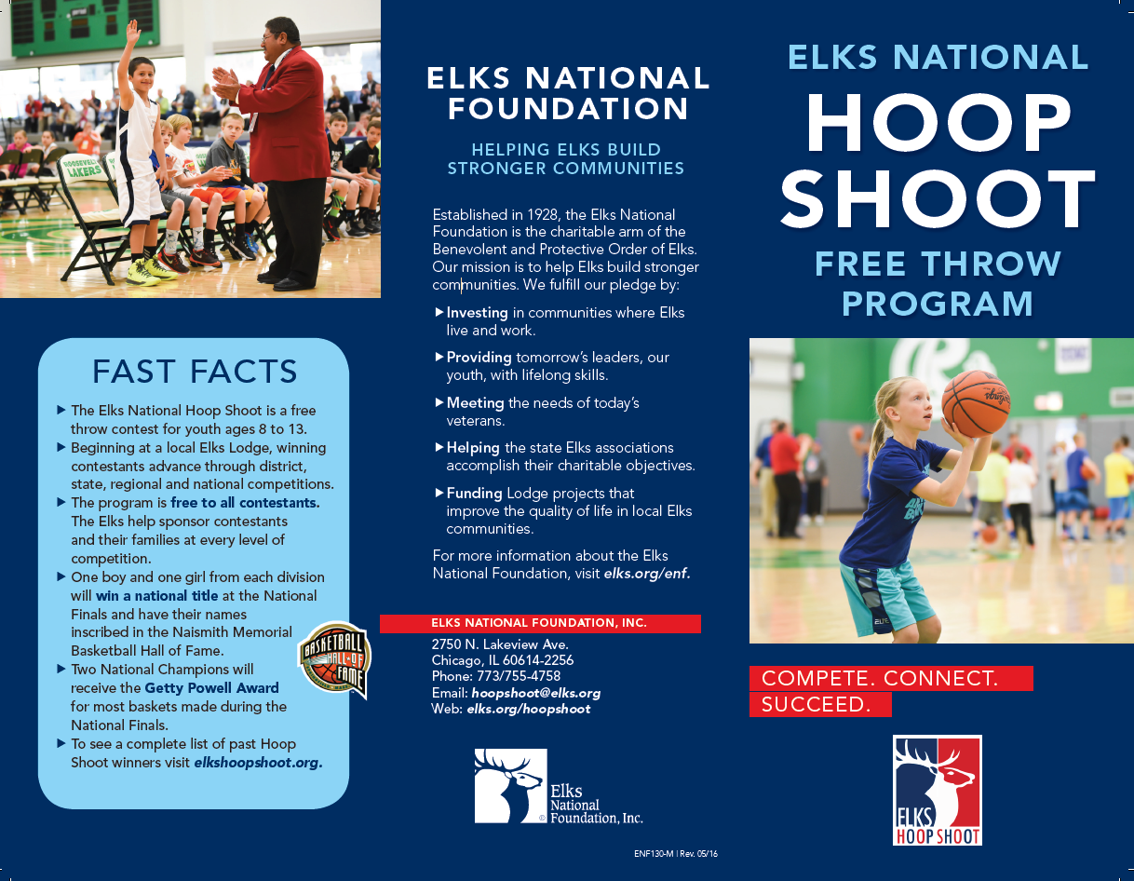

Slide 3


Slide 4

Appoint a Hoop Shoot Director
Hoop Shoot Directors should be appointed by each Lodge’s Exalted Ruler.
The Lodge Secretary should enter the Director’s information as a Lodge Hoop Shoot Chair in CLMS. Please be sure that the Lodge Committee Chair has a valid email address. In order for Lodge Directors to have access to the Director’s Dashboard on the Hoop Shoot website, the Secretary must also appoint this person, or another member of the committee as the Hoop Shoot Coordinator under the Staff tab on CLMS. Contact the Elks National Foundation with any questions by emailing hoopshoot@elks.org.

Slide 5
Appointing a Hoop Shoot Coordinator
Lodge Secretary:
To help Lodge Hoop Shoot Directors manage their contests and move their winners on to the next level of competition, a Hoop Shoot Coordinator position has been created in CLMS.
Hoop Shoot Coordinators can access an online dashboard, called the Directors’ Dashboard, where they will manage all aspects of their contest, including entering winners’ information and reporting participation. They are not allowed to perform any secretarial functions and cannot access CLMS. Ideally, the Hoop Shoot Coordinator should be the Lodge Hoop Shoot Director. If you do not yet have a Lodge Hoop Shoot Director appointed, please do so. The coordinator must be a member of the Lodge, involved with the Hoop Shoot, and computer savvy.

Slide 6
How to Appoint a Hoop Shoot Coordinator
1. The Lodge Secretary should sign into CLMS.
2. From the homepage, click the CLMS2Web Staff tab at the top.
3. Click on the link labeled Appoint Hoop Shoot Coordinator. There will be a drop-down menu with all the members of your Lodge who currently have elks.org accounts. Select the name of the person you’d like to appoint, and then click the button labeled Appoint New Hoop Shoot Coordinator. If your Lodge Hoop Shoot Director does not have an elks.org account, he or she will have to register so that you can assign Hoop Shoot Coordinator access.
4. The appointment will be immediate, and the new Hoop Shoot Coordinator Directors’ Dashboard access privileges the next time he or she signs on using his or her existing elks.org user name and password.
If you have any questions, email hoopshoot@elks.org or call 773/755-4758.

Slide 7
Available on the Directors Dashboard
Promotional
Hoop Shoot PSA video
Contestant of the Week Form
Hoop Shoot Logo
Hoop Shoot Poster
How to Host a Preliminary Contest
Hoop Shoot Brochure
Hoop Shoot Film
News Release Tutorial
News Release Generator
Merchandise
Contest Apparel
Hoop Shoot Trophies
Contest Basketballs
Contest Materials
Hoop Shoot Participation Report
Registration Form
Score Card
Rules and Guidelines for Volunteers
Certificate of Insurance
Pocket Manual
Floor Plan
Keys to Success
Solutions
Speaking Points
Hoop Shoot Coordinator Instructions
Hoop Shoot Webinars

Slide 8


Slide 9
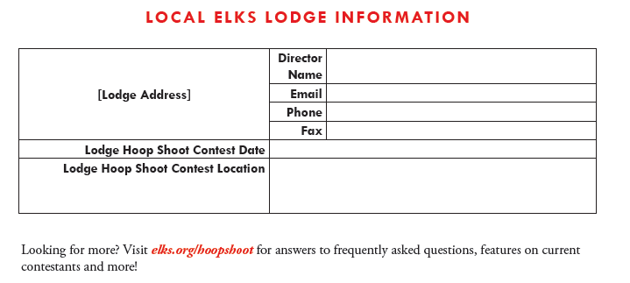
The Elks Invite you to HOST A HOOP SHOOT
The Elks Hoop Shoot is a free throw contest for children ages 8 to 13. The program is free to all contestants and provides youth an opportunity to compete, connect and succeed through hard work and healthy competition. The lessons learned at the Hoop Shoot help kids develop grit. Winners advance through Lodge, District, State and Regional Contests to reach the National Finals in April. In the end, the names of six national champions will be permanently inscribed at the Naismith Memorial Basketball Hall of Fame.
Everything you need to host a preliminary Hoop Shoot contest is included in this informational guide. For more information on the Hoop Shoot, contact your local Lodge using this information below.

Slide 10
Hosting a Hoop Shoot Contest
Hosting a Hoop Shoot is easy—all you need is a gym, a basketball and contestants! Follow these steps and contact your local Elks Lodge with any questions.
STEPS FOR HOSTING YOUR PRELIMINARY CONTEST
Choose a contest date and time. Work with your local Lodge’s Hoop Shoot Director to ensure your contest occurs prior to the Lodge’s contest. Invite students and youth in your community to participate.
Organize your contestants by age (see Eligibility Guidelines below).
After the contest, complete the participation form. List the total number of participants in your contest and the names of your six winners. Forward your completed form to your local Lodge’s Hoop Shoot Director.
Provide the six winners with the date and location of the local Lodge contest. The Lodge Hoop Shoot Director will provide this information.

Slide 11
Hosting a Hoop Shoot Contest
CONTEST DATE AND ELIGIBILITY
Contests organized by schools or community organizations may be conducted during the regular school day, i.e. during P.E. classes, or after school. If possible, invite your local Lodge Hoop Shoot Director to attend.
Schools and organizations should determine six winners, one from each division. The names of each winner should be recorded, and each winner should then move on to compete in the upcoming official Lodge contest.
AGE REQUIREMENTS
The Elks Hoop Shoot is open to all children, ages 8 to 13. Age groups are based on the contestant’s age on April 1, 2018.
If the contestant will be age 7 on April 1, 2018, is too young to participate.
If the contestant will be age 14 on April 1, 2018, is too old to participate.
There are six divisions: Boys 8-9 10-11 12-13 Girls 8-9 10-11 12-13
Be sure to accurately assign contestants to the correct age group. Winners who do not shoot in their correct age group will be disqualified from participating in the next level of competition. No exceptions.

Slide 12
Lodge Directors Checklist
Select a contest date and location. Ensure that the contest takes place at least two weeks prior to the district contest. Notify your District Director by October 1.
Invite youth from area schools and community organizations to participate. Provide them with promotional materials and keep them informed of the date and time of your Lodge contest.
Start your publicity three to four weeks before the contest. Distribute posters and brochures throughout the community, at schools and other organizations.
Select volunteers to be officials, scorers and chaperones. Review their duties with them and ensure they have a clear understanding of the rules.
If possible, have a doctor or nurse or EMT present. The Lodge likely has a member who could volunteer.
Verify the age of each contestant by birth certificate, passport, etc., and ensure that the proper age category is assigned to them.
Distribute letters to each contest winner and family, indicating the date and time of the next contest. You should personally deliver these letters to each family immediately after the contest. Letters can be found online under Directors’ Drills in the Lodge section at www.elks.org/hoopshoot.

Slide 13
Keys to Success:
Tips for Conducting a Successful Contest
BEFORE your contest:
A. READ and UNDERSTAND the rules. No guessing!
B. POST a copy of the rules for public view.
C. ANNOUNCE the age cut-off dates before placing contestants into age groups and beginning the contest. Do not wait until after contestants have participated to verify their ages.
D. REVIEW the contest rules with contestants before they participate in the Hoop Shoot.
E. INSTRUCT volunteers and chaperones on their duties and ensure that they have a clear understanding of Hoop Shoot Rules and Guidelines.
II. MAINTAIN a quiet atmosphere with the audience seated.
III. NEVER show or discuss your official scores with any parent or member of the audience for any reason.
IV. NEVER allow contestants to “re-shoot” for any reason.
V. MAKE IT FUN! Keep your contestants engaged and provide a quality experience for everyone involved.
V. INFORM your champions in writing of the date, time and location of the next contest.

Slide 14
Summary Contest Rules
The Hoop Shoot Director sets the time, date and location of the contest. All contestants should be notified of this information in advance.
All contestants must be present and ready to participate at the time the contest for their age category begins. In no case may a contestant shoot before or after the designated time set for his/her age-group. Shooting times are set by the Hoop Shoot Director. Contestants who shoot before or after their designated time will be disqualified. No exceptions.
Shooting positions will be drawn randomly. The method is left to the discretion of the Director.
All contestants should be allowed 10 minutes to warm up. Warm-ups should take place under the supervision of the contest officials.

Slide 15
Summary Contest Rules
A free throw is the opportunity given to the contestant to shoot a basket for score from within the free throw circle and behind the free throw line (except for 8 to 9 year old contestants, see Rule No. 6). A free throw begins when the ball is given to the contestant at the free throw line. It ends when the shot is successful; or when it is certain that the shot will not be successful; or when the ball becomes dead.
Contestants cannot bounce the ball more than four times between shots. If the ball is bounced more than four times, a penalty occurs and the shot is void.
The decision of the Head Scorer is final. No spectators, because of their count, can change the Head Scorer’s decision.
10. Contestants must stay behind the foul line until the ball has touched the hoop, backboard or net. The penalty for a line violation is the loss of a basket, if made.
11. Ties will be broken by taking five additional shots in the same shooting order as the regular contest.

Slide 16
Expenses
Lodge to District: Lodge Directors should accompany winners and their parent/guardian to the District contest. Any reasonable expenses incurred should be the responsibility of the sponsoring Lodge.
District to State: District Directors should accompany winners and their parent/guardian to the State contest. This could be an overnight trip. Any reasonable expenses incurred should be the responsibility of the sponsoring Lodge.
State to Regional: State Directors must accompany winners and their parent/guardian to the Regional contest. The Elks National Foundation will cover the expenses of transportation, housing and food for all winners and their parent/guardian. Details will be provided by the Regional Hoop Shoot Director. Date Las Vegas Nevada March 2-4 2018
Regional to National: The Elks National Foundation will coordinate and cover the expenses of transportation, housing and food for winners and their parents/guardians.
Date Chicago Illinois April 19-22 2018

Slide 17
Publicity
In the Hoop Shoot Directors’ annual supply kit, there are additional materials to help guide you in publicizing your contest. Please note: Hoop Shoot Directors at every level of the competition should work with the Public Relations Committee (if available) to contact available newspapers, radio and TV stations for media coverage. Provide the names of contestants, when they are available. Here are some additional tips to get your Hoop Shoot in the news:
Login to Directors’ Drills at www.elks.org/hoopshoot to utilize promotional tools like the ENF’s News Release Generator.
Provide local schools and community organizations with program fliers and posters.
Begin publicizing the event at least three to four weeks before the contest and continue your publicity each week.
Enlist a photographer to take pictures of the contestants practicing and give them, along with a news release, to your local paper for more publicity.
Explain who the Elks are and provide more information about the mission and purpose of the organization.

Slide 18
Awards
Lodge Contests: Certificates for Lodge winners may be downloaded from the Directors’ Drills page of the Hoop Shoot website. Visit www.elks.org/hoopshoot and click “Directors’ Drills”. Any other awards are purchased at the expense of the sponsoring Lodge.
District Contests: The Elks National Foundation will provide three first- place and three runner-up trophies for each age/gender division. Certificates of Participation are available online. To download certificates, visit www.elks.org/hoopshoot and click “Directors’ Drills”. Any other awards are purchased at the expense of the District or State Association.
State Association: The Elks National Foundation will provide three first-, second- and third- place trophies for each age/gender division. Certificates of Participation are available online. To download certificates, visit www.elks.org/hoopshoot and click “Directors’ Drills”. Any other awards are purchased at the expense of the State Elks Association.
REMEMBER: You are not permitted to give any award of monetary value. Money, checks, bonds, gift certificates and scholarships are not allowed under any circumstance. Reimbursements for travel and housing will be paid directly to the contestant’s parent or guardian, never to the contestant.

